Slide 1
Data Structures & Algorithms (CSC-214)
Recursion

Slide 2
What is recursion?
Recursion is a programming technique where a function calls itself to solve smaller instances of the same problem.

Slide 3
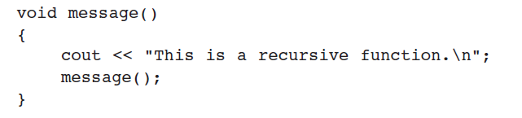
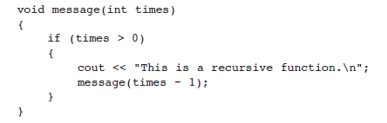
Recursion – Example (1)
A function that calls itself is called a recursive function

Slide 4
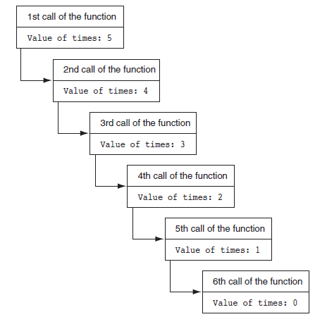
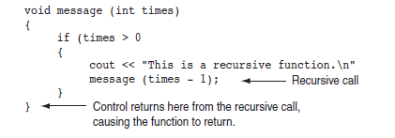
Recursion – Example (2)

Slide 5
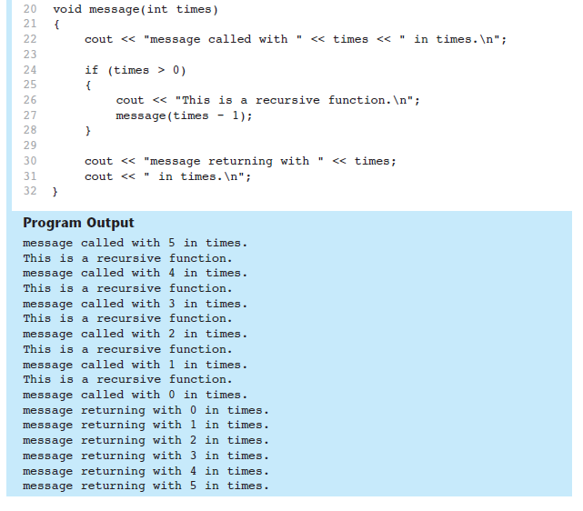
Recursion – Example (3)

Slide 6
Concept: Recursion
In general, a recursive function works like this:
If the problem can be solved now, without recursion, then the function solves it and returns (base case)
Base Case: Condition when recursion stops.
If the problem cannot be solved now, then the function reduces it to a smaller but similar problem and calls itself to solve the smaller problem (recursive case)
Recursive Case: Breaking the problem into smaller instances.
Important Rule: Every recursion must converge to a base case.

Slide 7
Concept: Recursion
Each recursion call gets its own stack frame
Stack grows till it reaches base case, then it unwinds

Slide 8
Concept - Recursion
Mistakes | Example
No base case | Infinite recursion
Incorrect base case | Wrong output
Missing return | Stack overflow

Slide 9
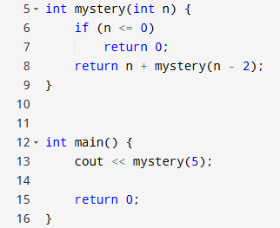
Concept - Recursion
Make a call stack for each function call

Slide 10
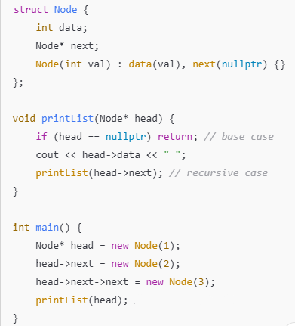
Concept - Recursion
What is the output?

Slide 11
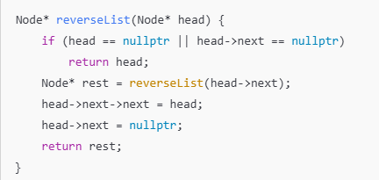
Concept - Recursion

Slide 12
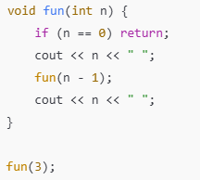
Concept - Recursion

Slide 13
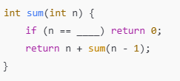
Concept - Recursion
Fill in the blanks to complete the recursion

Slide 14

Concept - Recursion
Identify the error

Slide 15
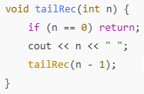
Concept - Recursion

Slide 16
Concept - Recursion
Always think Base Case First.
Trust recursion: Assume the smaller problem is already solved.
Visualize Call Stack behavior.

Slide 17
Practice Questions
Factorial

Slide 18

Factorial
The base case for recursion can be solved without recursion.
We can write the expression for the recursive part as well.

Slide 19
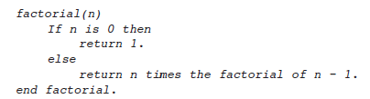
Factorial pseudocode
Try converting the following pseudocode to C++ code

Slide 20
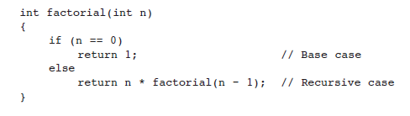
Factorial implementation

Slide 21
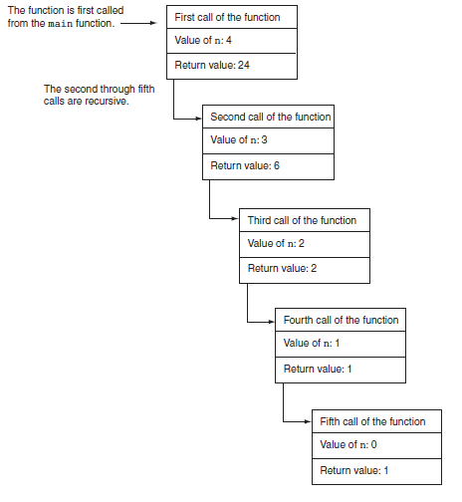
Factorial dry run

Slide 22

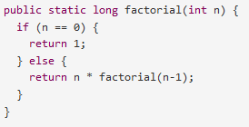
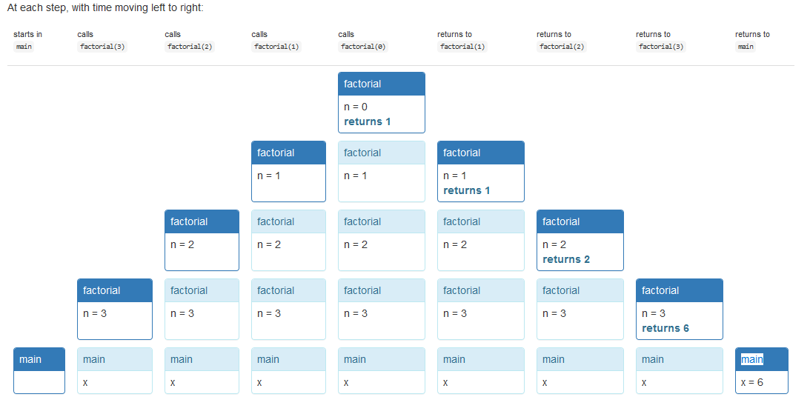
https://web.mit.edu/6.005/www/fa16/classes/14-recursion/

Slide 23
Practice Questions
Using recursion to count characters

Slide 24
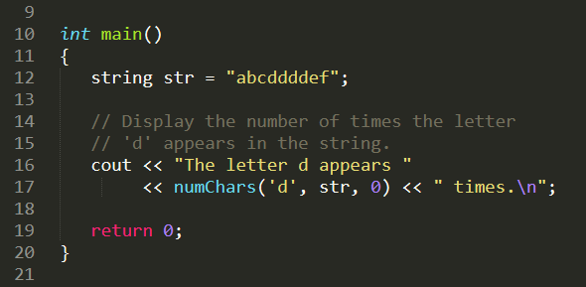
Count characters
Can you figure out the base case? recursive case?

Slide 25
Count characters
Can you figure out the base case? recursive case?
What are the possibilities when processing each character of the string?

Slide 26
Count characters
Can you figure out the base case? recursive case?
What are the possibilities when processing each character of the string?
Char doesn’t match
Char matches
Anything else?

Slide 27
Count characters
Can you figure out the base case? recursive case?
What are the possibilities when processing each character of the string?
Char doesn’t match
Char matches
Anything else? End of string

Slide 28
Count characters
What are the possibilities when processing each character of the string?
Char doesn’t match -> recursive as we still have to search the rest of the string
Char matches -> recursive as we still have to search the rest of the string
Anything else? End of string -> base case, no more characters to search
Function parameters:
search: the character to be searched for and counted
str: a string object containing the string to be searched
subscript: the starting subscript for the search

Slide 29
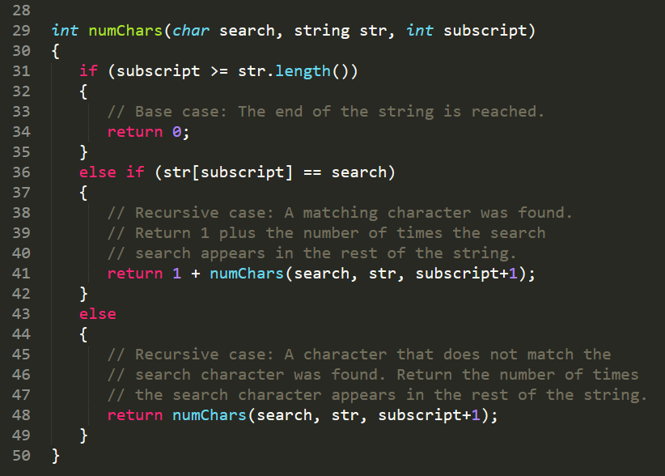
Count characters

Slide 30
Practice Questions
Fibonacci Series

Slide 31


Fibonacci Series
Can you figure out the base case? recursive case?
Series is:
Series looks like this:

Slide 32
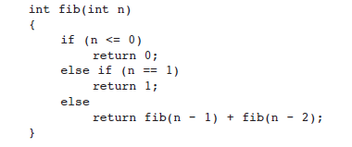
Fibonacci Series

Slide 33
Practice Questions
Recursion in linked lists

Slide 34
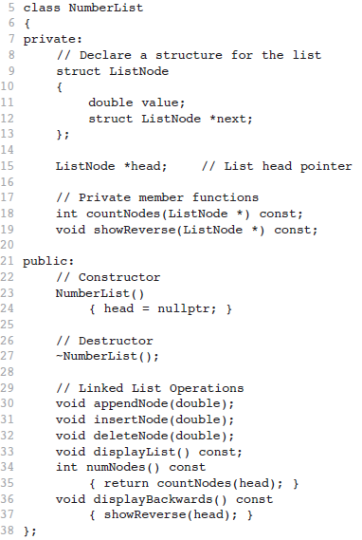

Slide 35
Counting Nodes in a Linked List
Iterative
Recursive
Can you figure out the base case? recursive case?
Can you write a pseudocode?

Slide 36
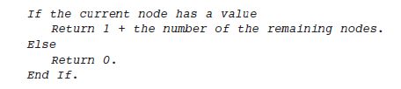
Counting Nodes
Pseudocode

Slide 37
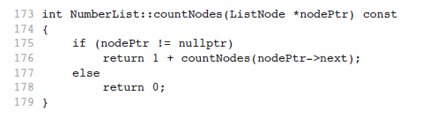
Counting Nodes
Pseudocode

Slide 38
Practice Questions
Printing singly linked list in reverse

Slide 39
Printing Linked List in reverse
Is there an iterative way to print a singly linked list in reverse?
Recursive way?
Recap:
If the problem can be solved now, without recursion, then the function solves it and returns (base case)
If the problem cannot be solved now, then the function reduces it to a smaller but similar problem and calls itself to solve the smaller problem (recursive case)
Keeping this in mind
Base case -> 1 node
Recursive case -> reaching that 1 base case node
How will we iterate over the linked list

Slide 40
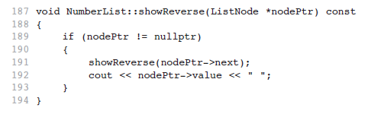

Slide 41
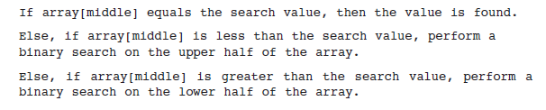
Recursive Binary Search
Values in the array should be sorted.

Slide 42
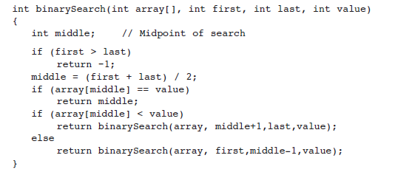
Recursive Binary Search
Returns index if found, otherwise returns -1.

Slide 43
Binary recursion
When an algorithm makes two recursive calls, it is said to use binary recursion.

Slide 44
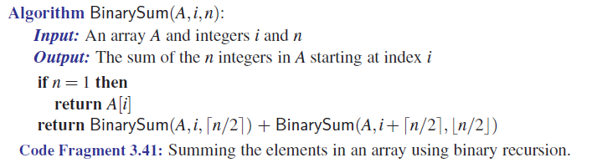
To keep things simple, assume n is a power of 2

Slide 45
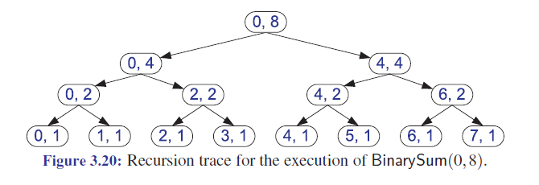

Slide 46
Multiple recursion
Generalizing from binary recursion, we use multiple recursion when a function may make multiple recursive calls, with that number potentially being more than two.

Slide 47
Lecture content adapted from Michael T. Goodrich textbook, chapter 3 & Tony Gaddis textbook chapter 19.

Slide 48
Any Questions?

